Slide 1
The Perceived Life Significance Scale: Measuring Experiential Contact with What Matters
Rachel Hibberd, Ph.D.
Durham VA Medical Center
Kaylin Jones, M.A.
University of Missouri-St. Louis
Brian Vandenberg, Ph.D.
University of Missouri-St. Louis

Slide 2
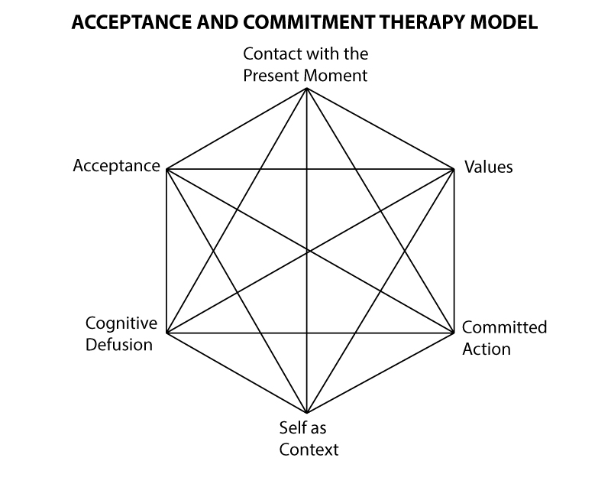
Perceived Life Significance Scale
Which ACT process?
Notes:
Pass out scale--- is there a certain point on the hexaflex it seems to be tapping?
My intention for talk: present this measure, get feedback, basically offer it in the hopes that it can be useful for contextual behavioral science.
Backstory of the measure:
Developed it for my dissertation because I was studying meaning and bereavement, and finding that nobody was really talking about what was most important. And that is, the phenomena of finding something to be really important. Then later I found ACT, which is animated at its very core by a discussion of what matters. So you’ll see that in some ways this measure reflects me coming from this stress-and-coping perspective, not informed from bottom up behavioral research. Yet, looking around at other ACT measures, it seems like it could be useful.
So I’ll talk first about the measure, and where it’s coming from and then try to link it up with ACT.

Slide 3
Bereavement: The Basics
Everybody dies
You can’t control bad things
Some good people suffer terribly
Human intimacy and connection inevitably entails loss

Slide 4
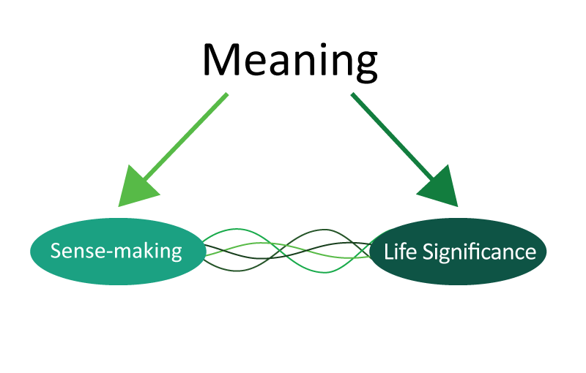

Slide 5
Life Significance
“The felt perception of value associated with a goal, relationship, or aspect of life experience that exists or is pursued in the present and future.”
Hibberd, 2013

Slide 6
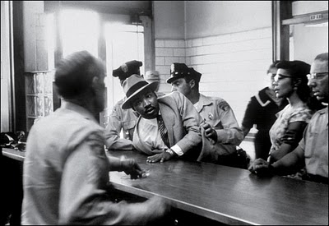
Life Significance

Slide 7
Hedonic well-being: balance
of pleasure versus displeasure.
May include: positive
mood, absence of negative mood,
life satisfaction.
Eudaimonic well-being: pursuit of other psychological “goods” in addition to happiness. May include: autonomy, personal growth, self-acceptance, relatedness, meaning
Notes:
Note: Life significance is conceptualized here as a desirable outcome of psychologically flexible behavior. Important because meaning has typically been viewed as a “means to an end,” with the end being reduced distress. So, much like ACT, this program of research is about how people can get other psychological goods besides just not feeling bad.
Note: the measure is specifically designed to be applicable regardless of the content of values, but has more people-friendly language to capture the actual experience of what it’s like to be in contact with values. Thus, would expect it to be a little more sensitive than measures that have the word “value” in every item. Of course, a downside of this is that it is also fairly culture- and language- bound.

Slide 8
Values
“Freely chosen, verbally constructed consequences of ongoing, dynamic, evolving patterns of activity, which establish predominant reinforcers for that activity that are intrinsic in engagement in the valued behavioral pattern itself.” (Wilson, 2009, 66)

Slide 9
Values
“According to RFT, values are essentially motivative augmental rules, that is, verbal relational networks…that increase the degree to which events associated with the valued domain function as reinforcers for particular values-based actions.” (Dahl et. al., 2009)

Slide 10
Values in ACT
Values are “verbal”
Values are about “patterns of behavior”
Relevant outcome is behavioral
“My behavior was consistent with my value”
Chronic Pain Values Inventory (McCracken & Yang, 2006)
Survey of Guiding Principles (Ciarrochi & Bailey, 2008)
Personal Values Questionnaire II (Blackledge, Ciarrochi, & Bailey)
Valued Living Questionnaire (Wilson, Sandoz, & Kitchens, 2010)
Bulls-Eye Values Survey (Lundgren et. al., 2012)
Notes:
Or” My behavior was consistent with the value”
Exception: Engaged Living Scale
Measures both values and committed action, an engaged response style

Slide 11
Life Significance
“The felt perception of value associated with a goal, relationship, or aspect of life experience that exists or is pursued in the present and future.”
Hibberd, 2013
OR:
“Experiential contact with intrinsic reinforcement conditioned to a goal, relationship, or….”

Slide 12
Perceived Life Significance Scale
Three subscales:
Active Life Significance
“I really care about what I’m doing with my life.”
Negative Life Significance
There’s nothing in my life that really matters.”
Receptive Life Significance
“There are moments when I’m powerfully aware of how valuable life is.”

Slide 13
Development and Validation of the PLSS
Qualitative item generation
Two groups:
Item selection:
353 Community bereaved adults
Confirmatory analyses:
483 Bereaved undergraduates

Slide 14
Validity
Reliability
Factor structure stable across groups
Convergent/discriminant validity
Criterion validity
Discrimant vs. “sense-making”
Copies of the measure paper available on request!
☺

Slide 15
Future Directions
Trauma and Bereavement
My not-so-secret agenda
ACT outcome research
Moral injury study…?
ACT/RFT basic science
Ecological momentary assessment?
Lab induction?

Slide 16
“The existential psychologists and psychiatrists do not rule out the study of... patterns of behavior. But they hold that these cannot be understood in any given person except in the context of the overarching fact that here is a person who happens to exist, to be.”
--Rollo May, 1983

